Slide 1


Shock Reformation Generating High-speed Magnetosheath Jets Savvas Raptis Division of Space and Plasma Physics KTH Royal Institute of Technology, Stockholm, Sweden Co-authors : T. Karlsson (KTH), A. Vaivads (KTH), C. Pollock (Denali Scientific), F. Plaschke (Technische Universität Braunschweig), A. Johlander (IRF, Uppsala), H. Trollvik (KTH), P-A. Lindqvist (KTH) EGU 2022 – Vienna, Austria 27/05/2022
Raptis, S., Karlsson, T., Vaivads, A. et al. Downstream high-speed plasma jet generation as a direct consequence of shock reformation. Nature Communications 13, 598 (2022). https://doi.org/10.1038/s41467-022-28110-4

Slide 2
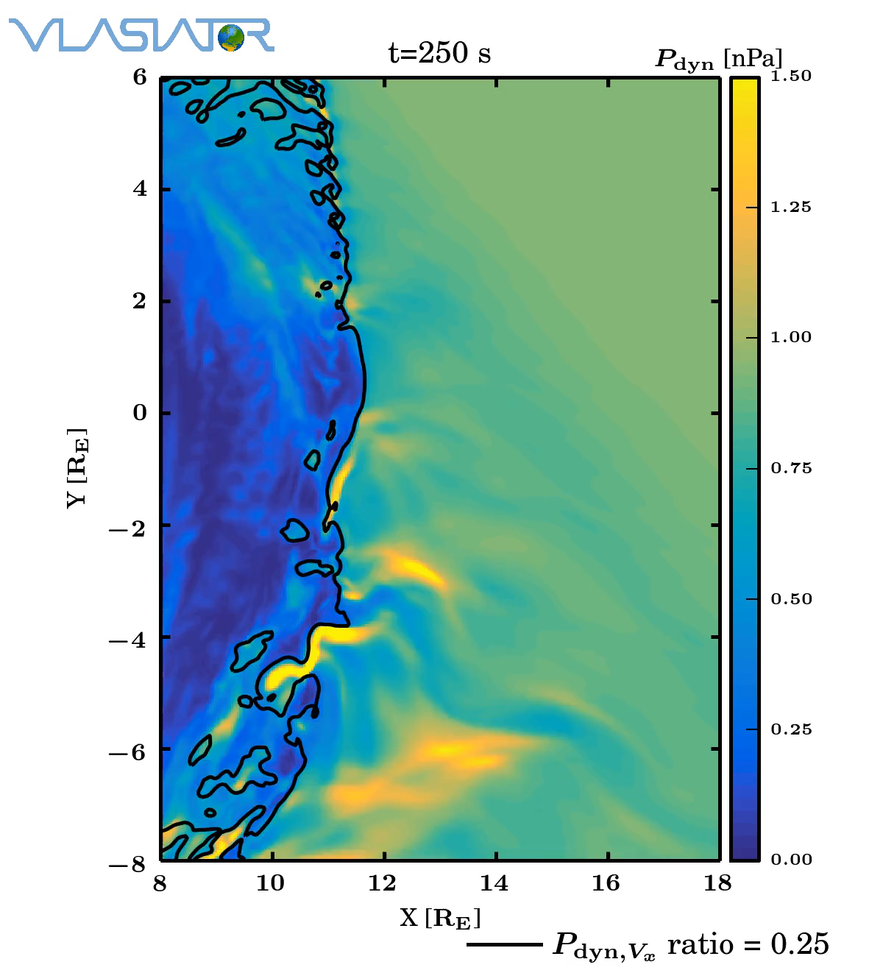
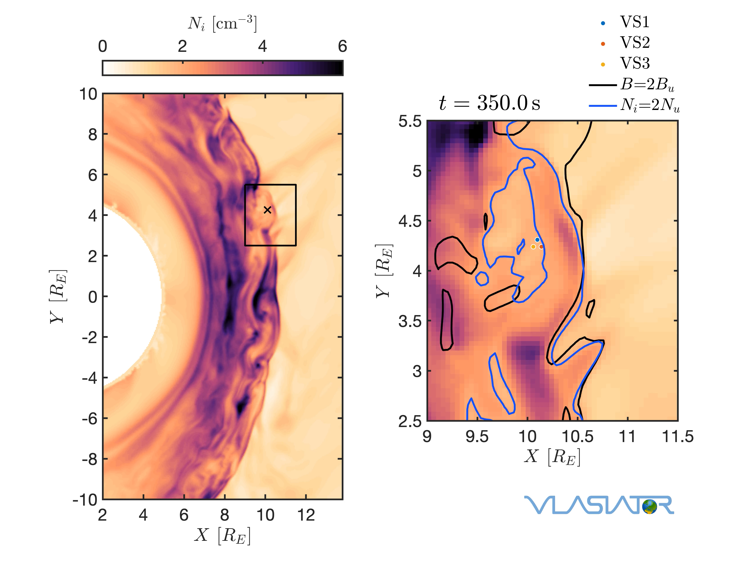
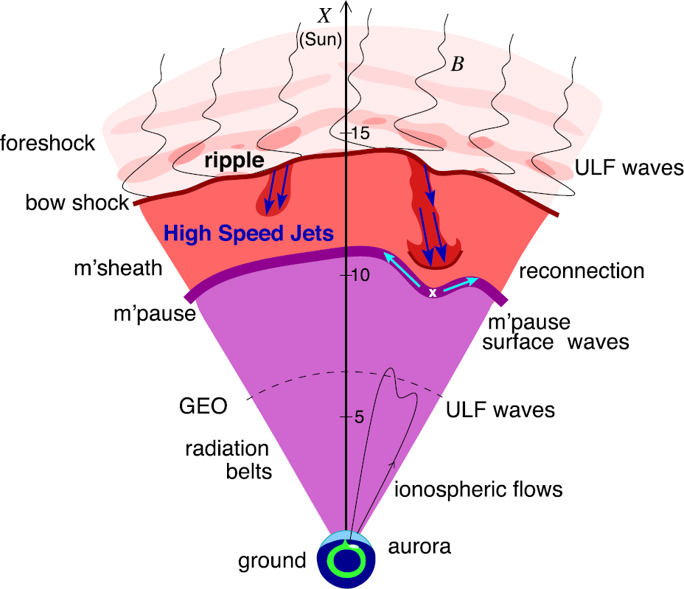
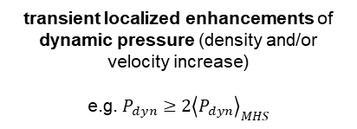
Introduction | Results | Discussion
Title = Shock Reformation Generating High-speed Magnetosheath Jets
Title = Shock Reformation Generating High-speed Magnetosheath Jets
Title = Shock Reformation Generating High-speed Magnetosheath Jets
Title = Shock Reformation Generating High-speed Magnetosheath Jets
Shock & Jets
Generation
Reformation
transient localized enhancements of dynamic pressure (density and/or velocity increase)
e.g. $P_{dyn}≥2{\left\langle P_{dyn}\right\rangle }_{MHS}$
Hietala et al. (2009)
Archer et al. (2012)
Karlsson et al. (2015), Suni et al. (2021)
Burgess (1989): “the shock exhibits a cyclic behavior ….. cyclic shock reformation;”
Ripples? SW discontinuities ? Foreshock?
Plaschke et al. (2018); sketch by H. Hietala
Palmroth et al. (2018, 2021)
Johlander et al. (2022)

Slide 3
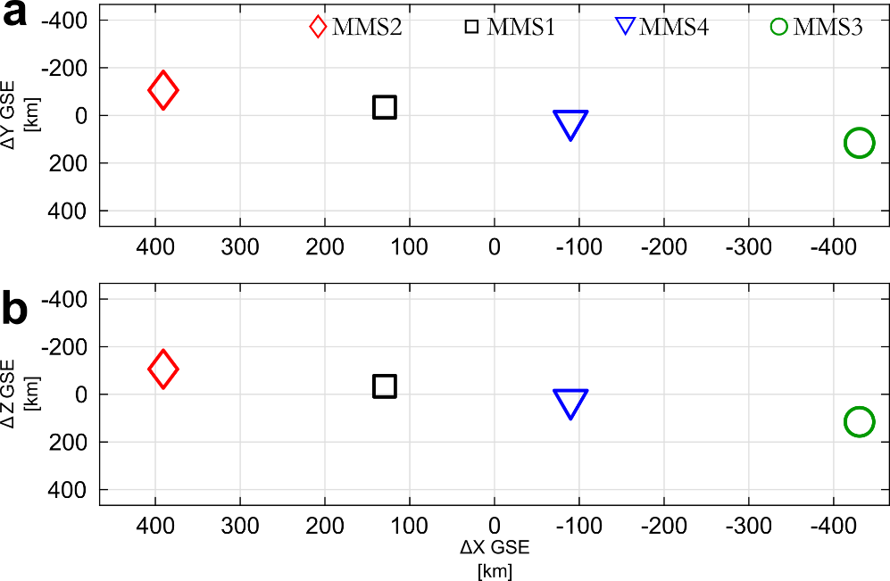
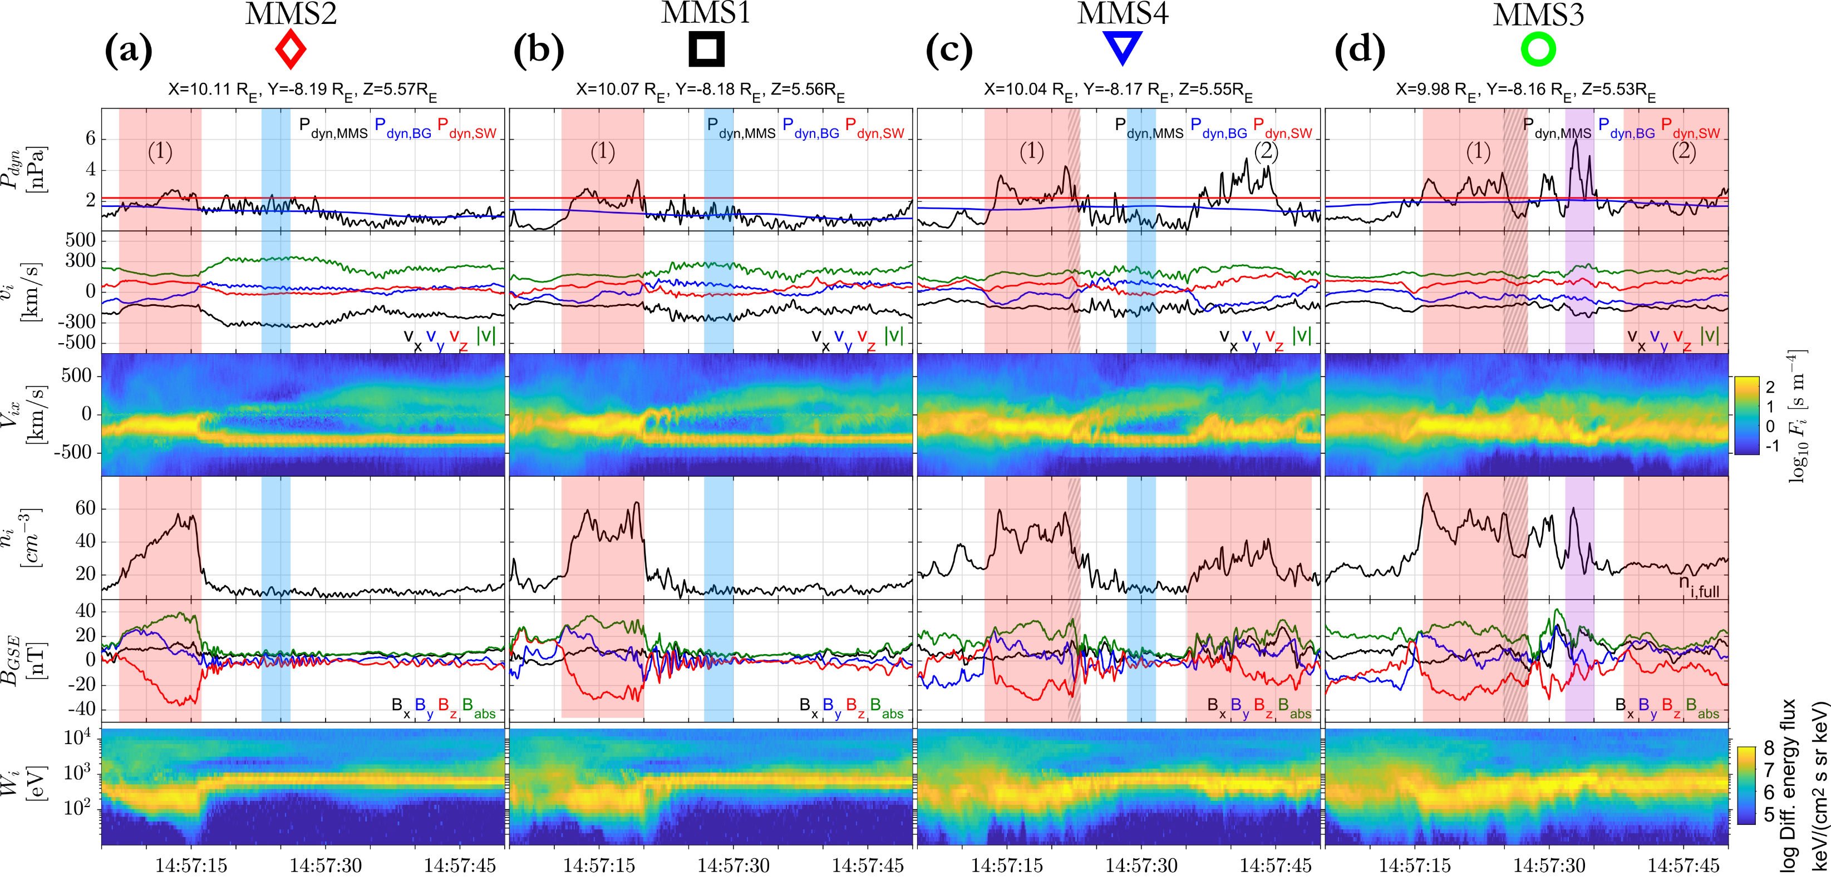
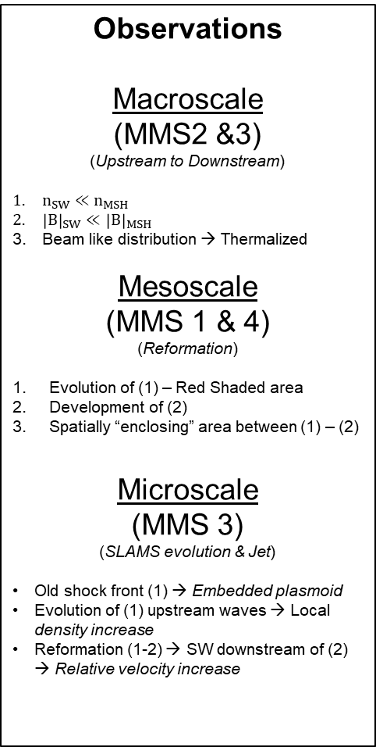
Introduction | Results | Discussion
u
d
Jet is formed from (1)’s upstream wave evolution (density increase) and reformation (1-2) (relative velocity increase)
Observations
Macroscale
(MMS2 &3)
(Upstream to Downstream)
$n_{SW}≪n_{MSH}$
${\left|B\right|}_{SW}≪{\left|B\right|}_{MSH}$
Beam like distribution → Thermalized
Mesoscale
(MMS 1 & 4)
(Reformation)
Evolution of (1) – Red Shaded area
Development of (2)
Spatially “enclosing” area between (1) – (2)
Microscale
(MMS 3)
(SLAMS evolution & Jet)
Old shock front (1) → Embedded plasmoid
Evolution of (1) upstream waves → Local density increase
Reformation (1-2) → SW downstream of (2) → Relative velocity increase

Slide 4
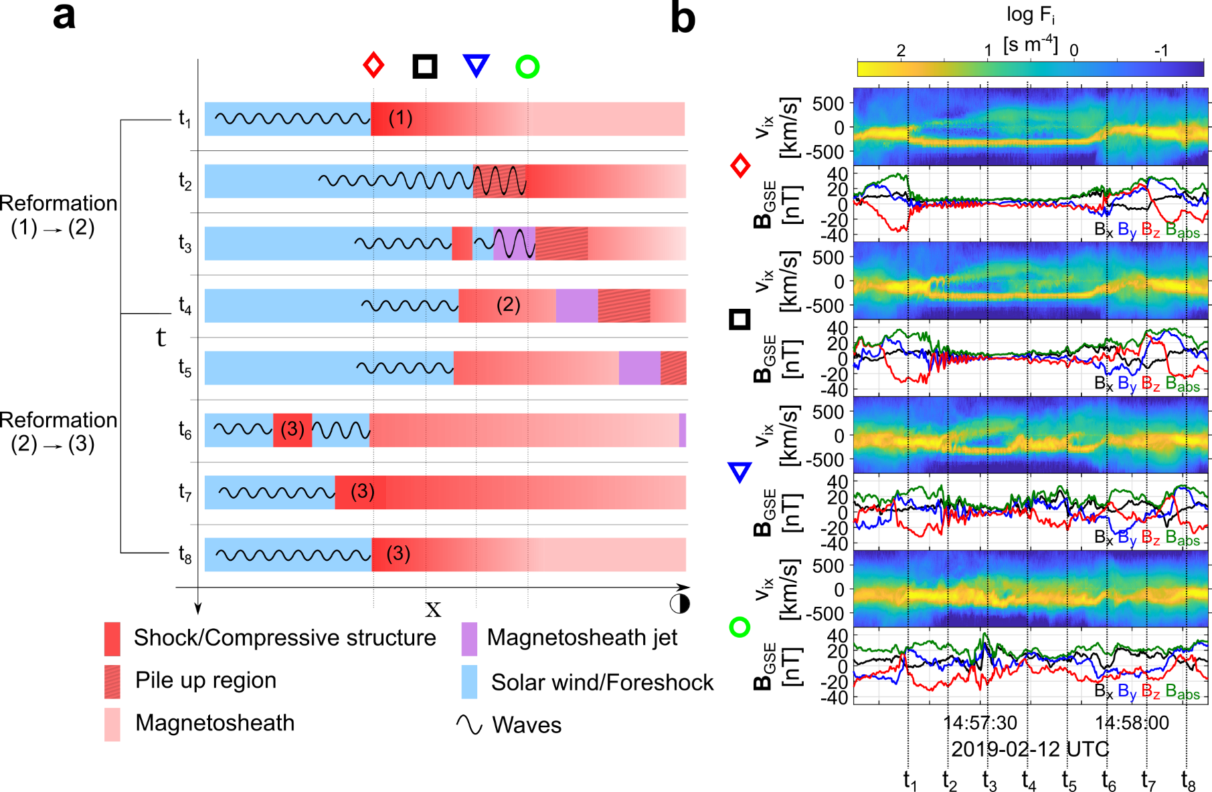
Introduction | Results | Discussion
Model of the shock evolution, reformation and
the generation of a magnetosheath jet.
Main points
Shock fronts become “embedded plasmoids” (density enhanced downstream regions).
Jets forming from the evolution of collisionless shock (reformation & upstream waves)
Implications & open questions
Is this a general property of shocks (astrophysical, planetary, lab) ?
If this mechanism is applicable to all jets, are they an extension of the foreshock evolution ?
Future work
Details on SLAMS/waves – Exact properties & evolution study of FCs numbered 1-3
Simulation comparison – Can we find cases like these in simulations ?
Statistics – We need more events, currently found ~3 of similar signatures.
Modeling – Can this process explain jets close to MP ? Or are just a subset of “small” jets ?
Article: https://www.nature.com/articles/s41467-022-28110-4
GitHub: https://github.com/SavvasRaptis/Jets-Reformation
Popular science version: https://astronomycommunity.nature.com/posts/how-the-solar-wind-slips-through-earth-s-bow-shock

Slide 5
Extras

Slide 6

Fast/Survey MMS data
Burst MMS data
Resolution (samples/s)
Resolution (samples/s)
FGM (magnetic field):
FPI (plasma moments | ions):
EDP (electric field):
0.0625
4.5
0.0313
0.0078
0.15
0.00012218
Pros
Always available
Decent resolution
Can be good for statistics due to availability
Pros
Very high resolution
Able to resolve structures close to boundary surfaces (e.g. mix of plasma close to magnetopause, bow shock, foreshock etc.)
Cons
Not available all the time, mostly available close to vital mission objectives (magnetopause, diffusion regions, shock transitions etc.)
Hard to do proper large scale statistics due to biases generated from specific availability and manual choice of intervals
Cons
Not suitable for small scale studies
Could be misleading close to boundary surfaces (Magnetopause, Bow shock etc.)
More information: Baker, et al. (2016) | Space Sci Rev 19

Slide 7
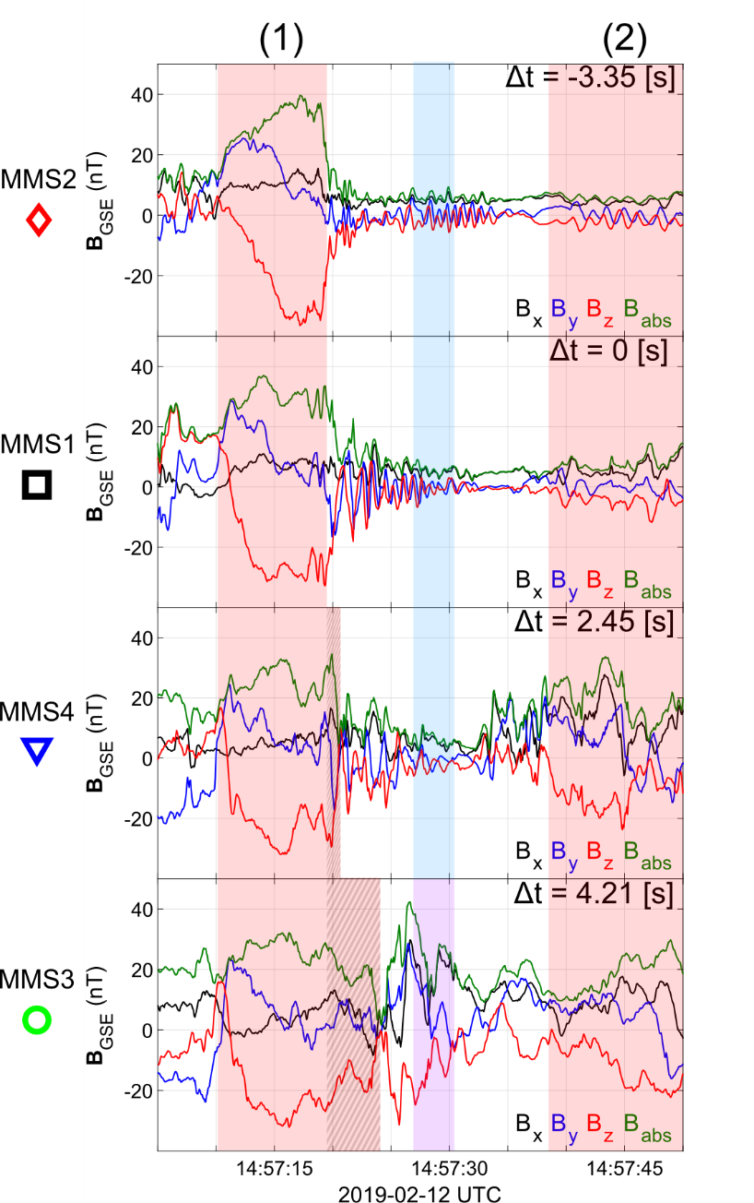

SLAMS & wave activity co-moving picture
Evolution of SLAMS
Interaction with upstream whistler
New peak /evolution*
Formation of embedded plasmoid (downstream density enhancement)**
* See similar examples by Turner et al. (2021), Chen et al. (2021)
** See similar example by Liu et al. (2021)

Slide 8
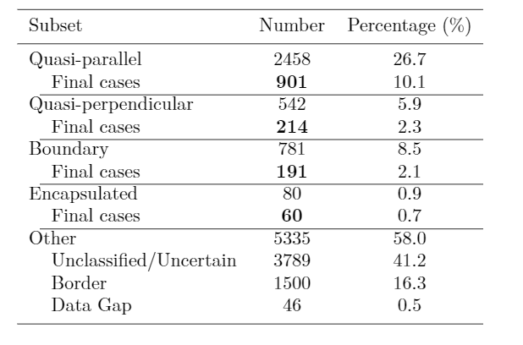
MMS – Jet Database
Fast/Survey
Burst
9/2015 - 9/2020
Jets with full burst data
Qpar | 423
Qperp | 34
Boundary | 35
Encapsulated | 31
Close to BS / MP | 495
Others | 428
Raptis S., Karlsson T., et al. (2020) | JGR
Raptis S., Aminalragia-Giamini S., et al. (2020) | Frontiers
Palmroth M., Raptis S., et al. (2021) | Annales
Kajdic P., Raptis S., et al. (2021) | GRL
Raptis S., Karlsson T., et al. (2022) | Nat. Commun
Raptis S., Karlsson T,, et al. (2022) | Ongoing

Slide 9
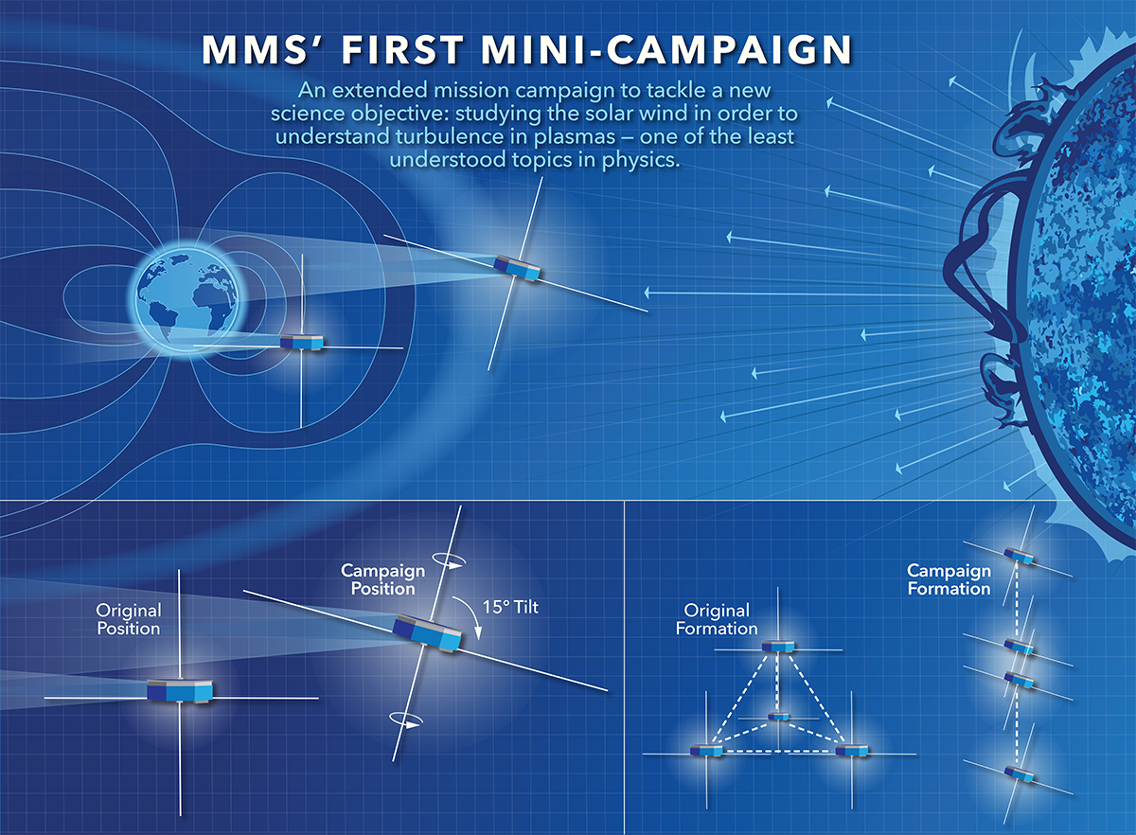


MMS spacecraft + String of Pearl Configuration
Bow Shock
Magnetopause
Earth
Credits: NASA's Goddard Space Flight Center/Mary Pat Hrybyk-Keith

Slide 10
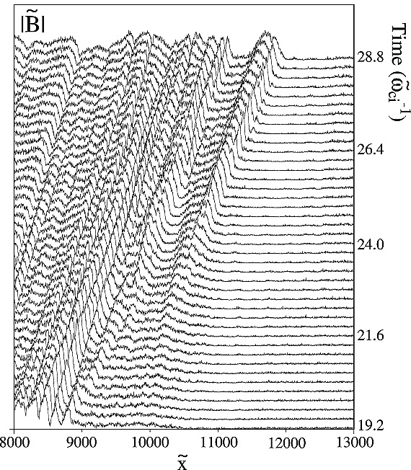
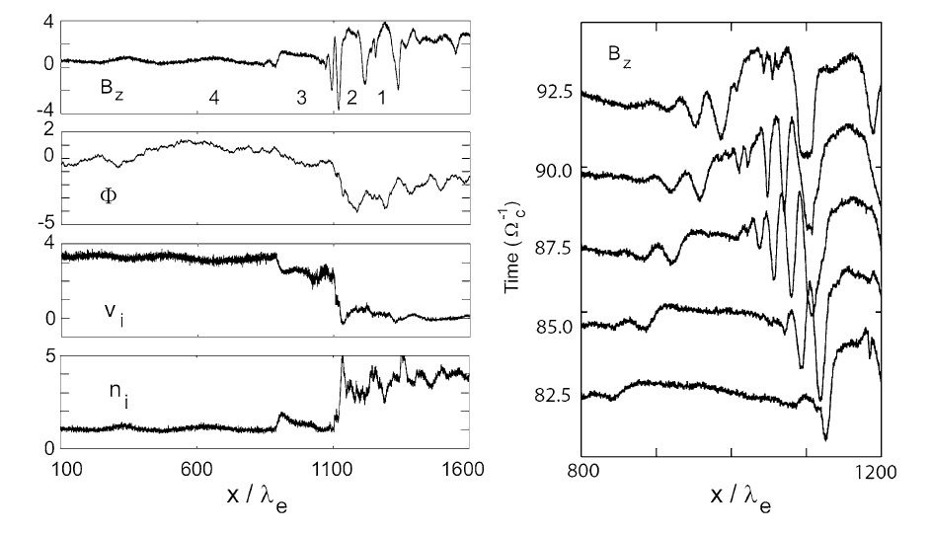
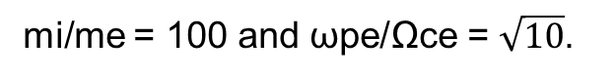
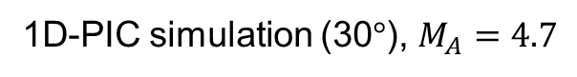
Shock Reformation – Simulations
1D-PIC simulation (30$°$), $M_{A}=4.7$
mi/me = 50 and ωpe/Ωce = 4.
mi/me = 100 and ωpe/Ωce = $\sqrt{10}$.
Scholer et al. (2003) | JGR
Tsubouchi & Lembège (2004) | JGR
More nice sources for review : Burgess & Scholer (2015), Willson (2016)
Notes:
Scholer : MA = 4.7 shock with a mass ratio of mi/me = 100 and ωpe/Ωce = √10 are shown in Fig. The total system size for this simulation is 200c/ωpi.

Slide 11
Jets – references update (>2019)
Associated phenomena & effects
Excitation of surface eigenmodes at magnetopause: Archer et al. (2019, 2021)
Mirror mode waves and jets : Bianco-Cano et al. (2020)
Bursty magnetic reconnection at the Earth's magnetopause : Ng et al. (2021)
Ground-based magnetometer response : Norenius et al. (2021)
Generation of Pi2 pulsations : Katsavrias et al. (2021)
B in jets, Bz variations near magnetopause : Vuorinen et al. (2021)
Modeling & formation
Velocity & magnetic field alignment in jets : Plaschke et al. (2020)
Classification of jets using MMS & Neural Networks : Raptis et al. (2020a,2020b)
Comparison MMS vs simulations : Palmroth et al. (2021)
Solar wind effect on jet formation : LaMoury et al. (2021)
Magnetosheath Jets and Plasmoids - Hybrid Simulations : Preisser et al. (2020)
Formation of jets in Quasi-perpendicular magnetosheath : Primoz et al. (2021)
Jets Downstream of Collisionless Shocks
Plaschke et al. (2018)
https://link.springer.com/article/10.1007/s11214-018-0516-3
And more : Liu et al. (2020a,2020b), Omelchenko et al (2021), Sibeck et al. (2021), Suni et al. (2021), Tinoco-Arenas et al. (2022) … etc. etc.

